Slide 1

ENSN201 – Enterprise Social Networks
Version 2 – 18th December 2015

Slide 2
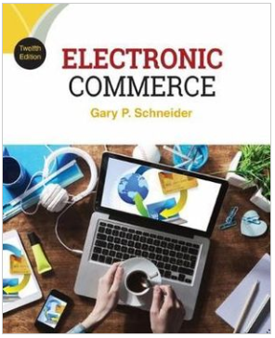
Resource Material
Electronic Commerce, 12th Edition
Gary Schneider
ISBN-10: 1305867815 | ISBN-13: 9781305867819 © 2017
Cengage Learning Australia

Slide 3
Week 7 : Chapter 13
Payment Systems for Electronic Commerce

Slide 4
Learning Objectives
In this chapter, you will learn:
What the most common online payment systems are and how they function
How payment cards are used in online retail transactions
What stored-value cards are and how they are used in electronic commerce
What challenges and opportunities are presented by the use of digital cash
Notes:
4
4

Slide 5
Learning Objectives
How digital wallets facilitate online transactions through computers and mobile devices
How the banking industry uses Internet technologies
Notes:
5
5

Slide 6
Introduction
Financial technology (fintech) is the use of powerful Internet-connected computers that use tools to improve quality and reduce cost of services
Existing and entirely new financial products
Includes online payment system not operated by banks
Facilitates purchases and other money transfers
Convenient and becoming widely adopted
Has also revolutionized lending
Online loan services takes banks out of value chain at a reduced cost

Slide 7
Common Online Payment Methods
Cash, checks, credit cards, debit cards are the most common world methods used to pay for purchases
More than 90% of all US consumer payments
Electronic transfer is a small percentage
Mostly automated payments from checking accounts
Credit and debit cards used for more than 60% of online payments with alternative systems such as PayPal used for the remainder
Convenient for customers and cost effective for businesses and provides a significant environmental impact

Slide 8
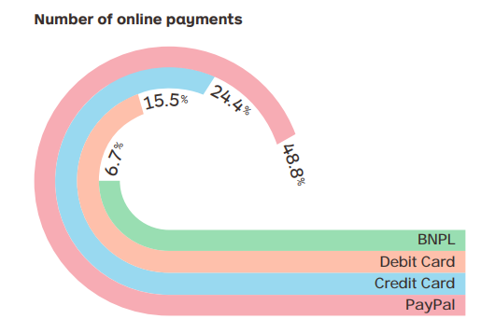
Buy now pay later
The adoption of BNPL continues to accelerate in Australia. BNPL is an appealing option, as unlike a credit card there is no service fee for customers who pay on time.
Millennials, those born after 1981 and who are 18+, are the fastest adopters of BNPL. These shoppers are more likely to be female (78.7%) and of a younger demographic. They are also frequent online shoppers, with 86% purchasing at least monthly.
Source: Australia Post’s Inside Australian Online Shopping Report for 2019.
FIGURE 11-1 Forms of payment for Australian online transactions

Slide 9
Electronic Bill Presentment and Payment Systems
Designed to deliver bills and accept payments
Success depends on ease of use and time required
Consumers choosing this option is increasing
70% of bills paid by check are now paid electronically which is a huge savings in paper, postage and time
Biller-direct systems are used by large companies who want to manage the systems themselves
Consolidator systems aggregate all a customer’s bills on one system mostly via banks
Not as attractive to billers because it requires a fee and delays receipt of funds

Slide 10
Micropayments and Small Payments
Micropayments are Internet payments for items costing few cents to a dollar
Barrier is people prefer to buy small value items in fixed price chunks rather than small payments in varying amounts
Many companies have developed micropayment systems but none gained broad acceptance
Small payments are payments of less than $10
Offered through mobile telephone carrier but held back by substantial charges for providing service
One of the largest markets is music downloads

Slide 11
Payment Cards
Payment cards are plastic cards used for purchases
Categories: credit cards, debit cards, charge cards, prepaid cards, and gift cards
Credit cards (Visa, MasterCard) have a spending limit based on user’s credit history
Pay off entire credit card balance or minimum amount with interest charged on unpaid balances
Widely accepted and provides consumer protection: 30-day dispute period
Card not present transactions include an extra degree of risk for merchant and bank

Slide 12
Payment Cards (cont’d.)
Debit card (electronic funds transfer at point of sale (EFTPOS) cards) removes funds from cardholder’s bank account and transfers it to seller’s account
Issued by bank with major credit card issuer's name
Charge card (American Express) has no spending limit with entire amount due at end of billing period
Retailers may offer their own store charge cards
Prepaid cards are called gift cards
Single-use cards had disposable numbers, valid for one transaction, but not adopted by consumers

Slide 13
Advantages and Disadvantages of Payment Cards
Advantage for merchants include fraud protection
Can authenticate and authorize purchases using a payment card processing network
Interchange network is a set of connections between banks and associations owning credit cards
For example advantage for U.S. consumers is limited fraud liability of $50 which is often waived if card is stolen
Merchants view the per-transaction and monthly processing fees as a cost of doing business
Consumers pay a slightly higher cost for goods due to these cards and some charge an annual fee

Slide 14
Payment Acceptance and Processing
Australian online and mail order stores normally ship merchandise within:
1-3 business days from dispatch - Australia Post - with door to door tracking.
Up to 7 to 12 business days - Standard mail with Stamp w/out tracking.
Processing payment card transactions online is a two step process
Payment acceptance is establishing card validity and verifying card’s limit not exceeded by transaction
Clearing the transaction includes all steps to move funds from card holder’s bank account into the merchant’s bank account

Slide 15
Open and Closed Loop Systems
With a closed loop system the card issuer pays merchant directly without a bank or clearinghouse
American Express, Discover Card
Issue cards directly to consumers
Open loop systems add additional payment processing intermediaries to the closed loop system
Visa, MasterCard issued by local bank
Visa and MasterCard are credit card associations operated by customer issuing banks who evaluate credit standing, establish credit limits and absorb non-payment losses

Slide 16
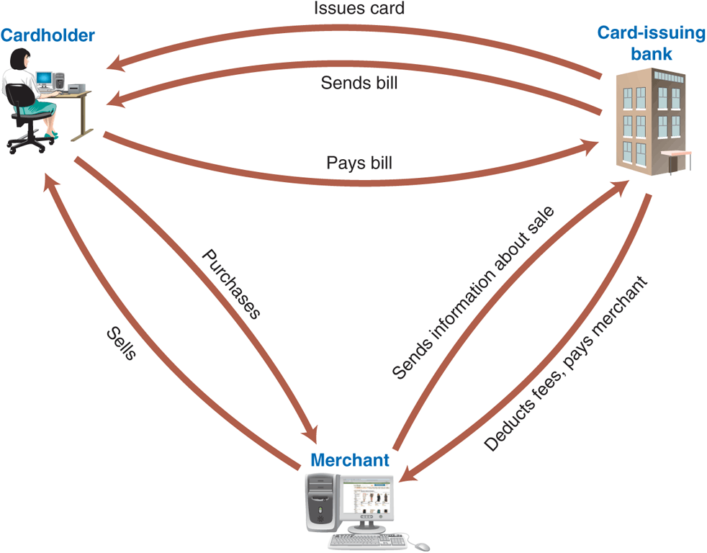
© Cengage Learning 2017
FIGURE 11-2 Closed loop payment card system

Slide 17
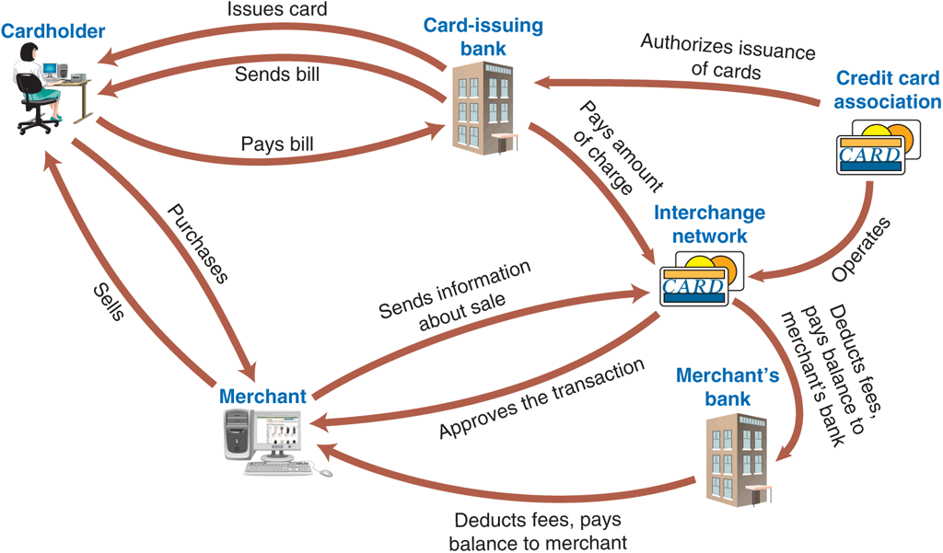
© Cengage Learning 2017
FIGURE 11-3 Open loop payment card system

Slide 18
Merchant Accounts
Acquiring bank does business with sellers that want to accept payment cards
Business must set up a merchant account with acquiring bank to process Internet transactions
One type similar to a checking account with bank collecting accounts net of processing fees
Commonly account acts like a credit line where the acquiring bank makes a non-interest bearing loan in the amount of daily net receipts, reduced by collections
Obtaining account requires merchant to provide business information and the bank to assess risk

Slide 19
Merchant Accounts (cont’d.)
Chargeback occurs when cardholder successfully contests charge
Acquiring bank must retrieve money from merchant account which may have funds on deposit
Acquirer fees are charges for providing payment card processing service
Per month and transaction, set by the acquiring bank
Interchange fees are charged at rates that depend on the merchant’s industry
Set by card association, charged to acquiring bank and usually passed along to merchant

Slide 20
Merchant Accounts (cont’d.)
Level of fraud is higher online
Under 15% of all credit card transactions responsible for 64% percent of total dollar amount of credit card fraud
Antifraud measures include
Scoring services that provide risk ratings for individual transactions in real time
Shipping only to card billing address and requiring card card verification numbers (CVNs) for card not present transactions
Three- or four-digit number printed on the credit card but not encoded on the card’s magnetic strip
20

Slide 21
Digital Cash
Also called electronic cash or e-cash
Describes any value storage and exchange system created by private (nongovernmental) entity
Does not use paper documents or coins
Can serve as substitute for government-issued physical currency
No common standard adopted so far
None adopted so far
Can be held in online storage or offline storage

Slide 22
Digital Cash (cont’d.)
With online cash storage consumer has no personal possession of digital cash
Trusted third party (online bank) involved in all transfers, holds consumers’ cash accounts
Merchant contacts consumer’s bank for payment
Helps prevent fraud (confirm valid cash)
Fills a need in developing countries that rely on cash as they conduct B2C electronic commerce

Slide 23
Digital Cash (cont’d.)
Bitcoin is the most well-known provider today
Online ledger book that tracks balances while participants remain anonymous
Public-key cryptography is used (cryptocurrency)
Large percentage of uses involve illegal purchases and currency speculation
Concerns include privacy and security, independence, portability, convenience
Must be impossible to spend more than once, easy to use and not traceable to the person who spent it
Anonymous digital cash

Slide 24
The Double-Spending Issue
Spending electronic cash twice by submitting the same electronic currency to two different vendors
Not enough time to prevent fraudulent act
Main deterrent is threat of detection and prosecution so system must provide traceability back to origin
Two-part lock provides anonymous security and signals an attempt to double-spend cash

Slide 25
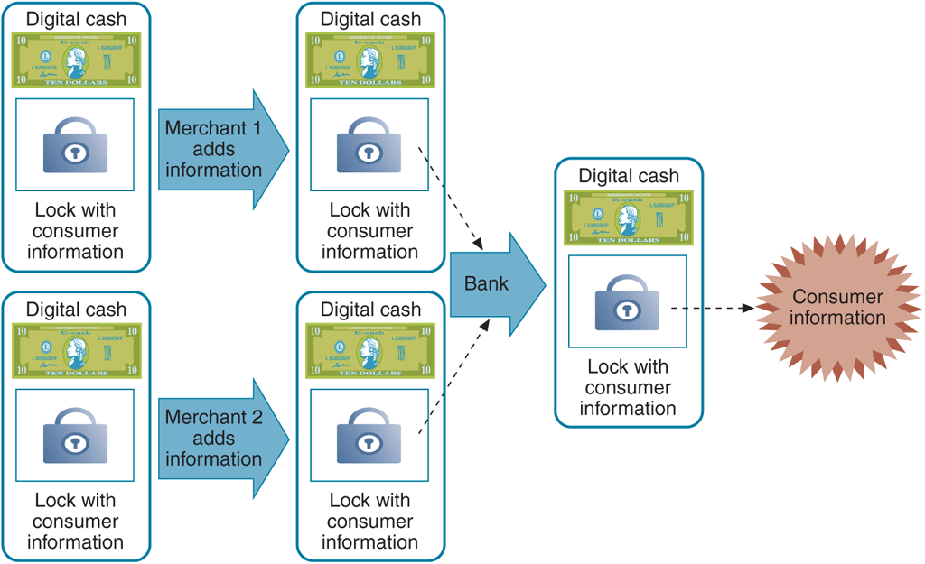
© Cengage Learning 2017
FIGURE 11-4 Detecting double spending of electronic cash

Slide 26
Advantages and Disadvantages of Digital Cash
Can be more efficient (less costly) than traditional payment methods
Less than processing credit card transactions or conventional money exchange systems
Does not require authorization
No audit trail (similar to physical cash) makes it non-traceable which can lead to money laundering
Convert illegally-obtained money into money spendable without being linked to illegal activity

Slide 27
Digital Wallets and Software-Based Digital Wallets
Allows customer to store name, address, credit card information on an electronic device or software
Benefit is customer enters information just once
Server-side digital wallet stores information on remote server of merchant or wallet publisher
Security breach can reveal thousands of users’ personal information to unauthorized parties
Google Wallet, Microsoft Windows Live ID, Yahoo! Wallet
Client-side digital wallet stores information on consumers computers
Must download wallet software onto every computer

Slide 28
Hardware-Based Digital Wallets
Implemented using smart phones or tablets
Store owner’s identity credentials (driver’s license, medical insurance card, store loyalty cards, etc.)
Transmit portions of information using Bluetooth or wireless transmission to nearby terminal
Near field communication (NFC) technology can be used if equipped with NFC chip
Google Wallet, Android Pay and Apple Pay
Security and privacy are major concerns
Must prevent unauthorized access

Slide 29
Internet Technologies and the Banking Industry
Paper checks still the largest dollar volume of payments in the word today
Processed through world’s banking system
Other major payment forms also involve banks
Internet technologies are providing new tools and creating new threats for the banking industry

Slide 30
Check Processing
Old method of physical check processing
Person wrote check which was deposited by retailer and sent to clearinghouse to manage funds transfer
Paper check transported to consumer’s bank and cancelled check sent to consumer
Disadvantages include transportation cost and float
Delay between time check is written and clears
Check Clearing for the 21st Century Act (Check 21) permits bank to eliminate movement of physical checks and use image scanning technology
Instant check clearing eliminates float

Slide 31
Mobile Banking
Banks exploring mobile commerce potential
Most banks offer apps for mobile devices
Check and transfer balances between accounts
View statements
Find an ATM
Some bank apps allow checks to be deposited by taking a picture
Vendors such as GoPayment and Square offer a tiny credit card reader that can be attached to a mobile device to take payments

Slide 32
Payment System Threats: Phishing and Identity Theft
Online payment systems offer attractive arena for criminals and criminal enterprises
Phishing attacks are techniques for committing fraud against online businesses customers
Particular concern to financial institutions

Slide 33
Phishing Attacks
Attacker sends e-mail message to accounts with potential for an account at targeted Web site
E-mail message tells recipient account compromised and recipient must log in to correct problem
Includes link that appears to be Web site login page
Actually leads to perpetrator’s site so that victim’s log in information can be captured and used
Spear phishing is a carefully designed phishing attack targeting a particular person or organization
Requires considerable research which increases change of e-mail being opened

Slide 34
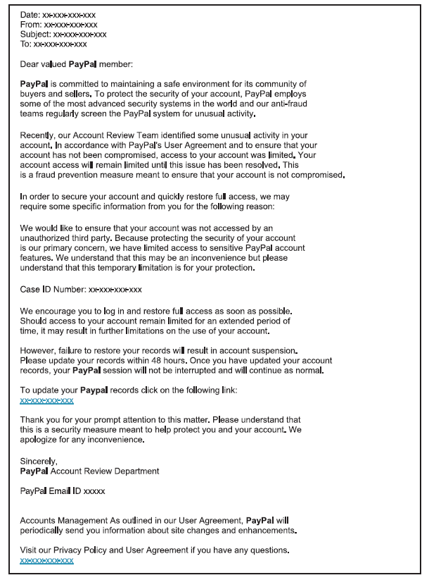
FIGURE 11-5 Phishing e-mail message
© Cengage Learning 2017

Slide 35
Phishing Attacks (cont’d.)
Example: 2008 government stimulus checks
Phishing e-mails that seemed to be from the IRS appeared within one week of passage
E-mail link disguise the real URL by using “@” which causes the Web site to ignore characters before it
https://www.paypal.com@218.36.41.188/fl/login.html
Phony site invisible due to JavaScript code
Pop-up windows look exactly like browser address bar including Web site graphics to make it even more convincing

Slide 36
Using Phishing Attacks for Identity Theft
Organized crime (racketeering) is unlawful activities conducted by highly organized, disciplined association for profit
Differentiated from less-organized groups
Internet providing new criminal activity opportunities
Generates spam, phishing, identity theft
Identity theft is a criminal act where perpetrator gathers victim’s personal information
Goal is to obtain credit
Perpetrator runs up account charges and disappears

Slide 37
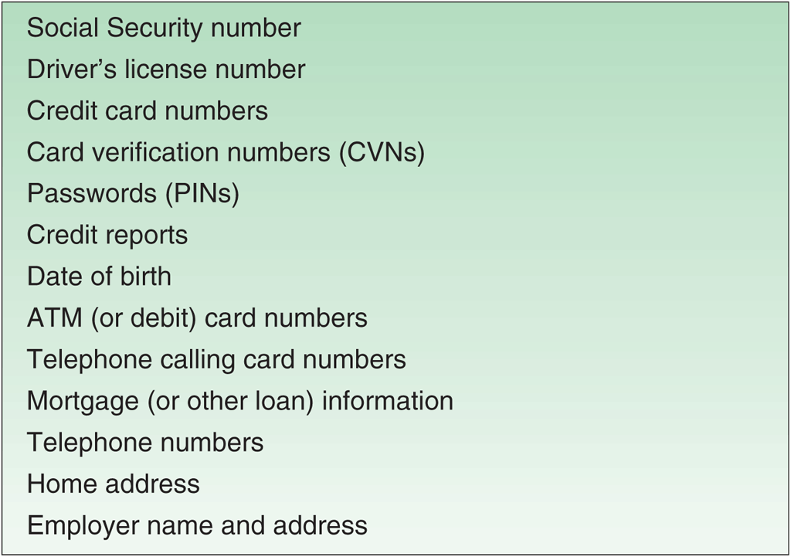
© Cengage Learning 2017
FIGURE 11-6 Types of personal information most useful to identity thieves

Slide 38
Using Phishing Attacks for Identity Theft (cont’d.)
Large criminal organizations can be highly efficient perpetrators of identity theft
Zombie farm is a large number of computers implanted with zombie programs
Pharming attack is the use of a zombie farm, often by organized crime, to launch a massive phishing attack
Phishing needs both collectors and cashers (users) of information which requires different skills
Crime organizations increase efficiency and volume by facilitating and participating in these transactions
Over a million victims and $1.5 billion lost annually

Slide 39
Phishing Attack Countermeasures
Spam is a key element of phishing attacks
Any protocol changes that improve e-mail recipients’ ability to identify message source reduces phishing
Educate Web site users
Contract with consulting firms specializing in anti-phishing work
Monitor online chat rooms used by criminals
Incidence of phishing has grown rapidly over the past two years and experts expect it will continue
Extremely profitable criminal activity

Slide 40

kent.edu.au Kent Institute Australia Pty. Ltd. ABN 49 003 577 302 ● CRICOS Code: 00161E ● RTO Code: 90458 ● TEQSA Provider Number: PRV12051

